Slide 1
Nuclear Energy and Climate Change: How Nuclear Energy can be a Catalyst for a Sustainable Energy Transition
Carlos Leipner
Executive Director, LGE Strategic Advisors
VP, ABDAN Conselho Curador
April 2024
ABDAN Nuclear Summit 2024 – Rio de Janeiro, Brazil

Slide 2
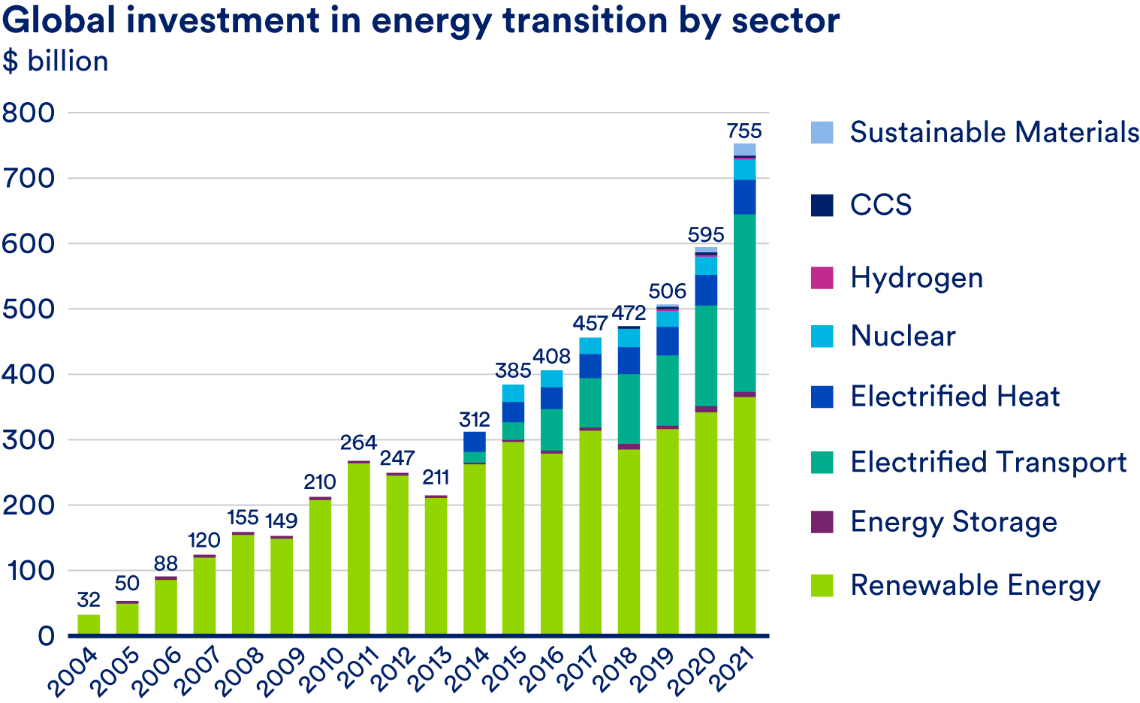
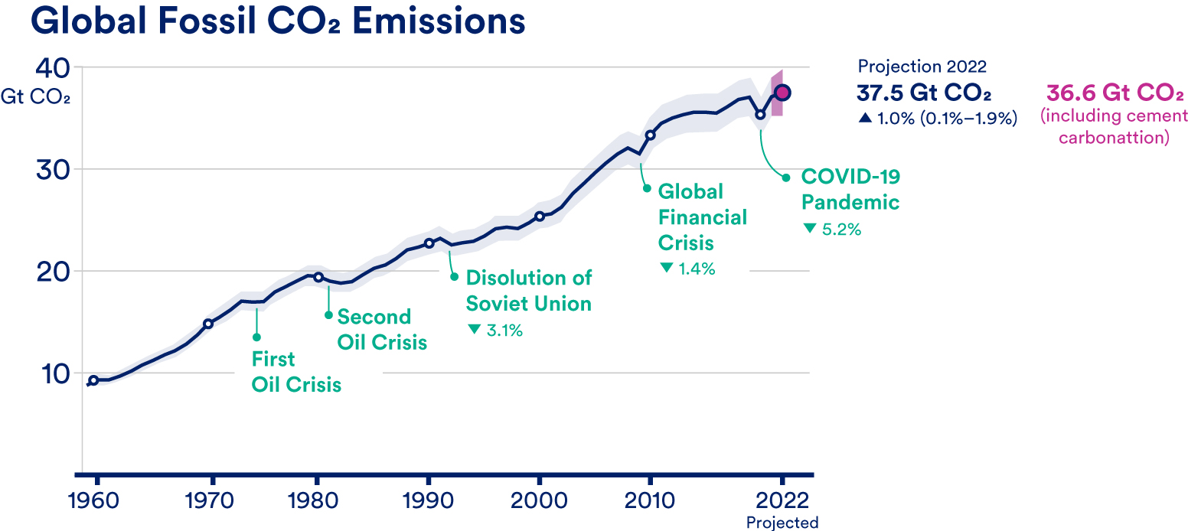
Opening thought
The world is spending more than $750 Billion per year on clean energy, most of it on EVs and renewables.
Yet, emissions continue to dramatically rise.
To gain more quickly on the climate problem, we need more aggressive deployment of zero carbon energy, and nuclear is an essential part of the portfolio.
But why isn’t nuclear growing?
Source: Bloomberg New Energy Finance
Source: Global Carbon Project

Slide 3
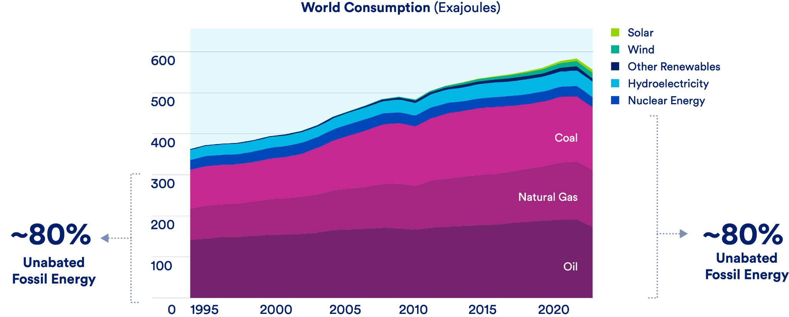
Kyoto Protocol
Paris Agreement
Ref: CATF

Slide 4
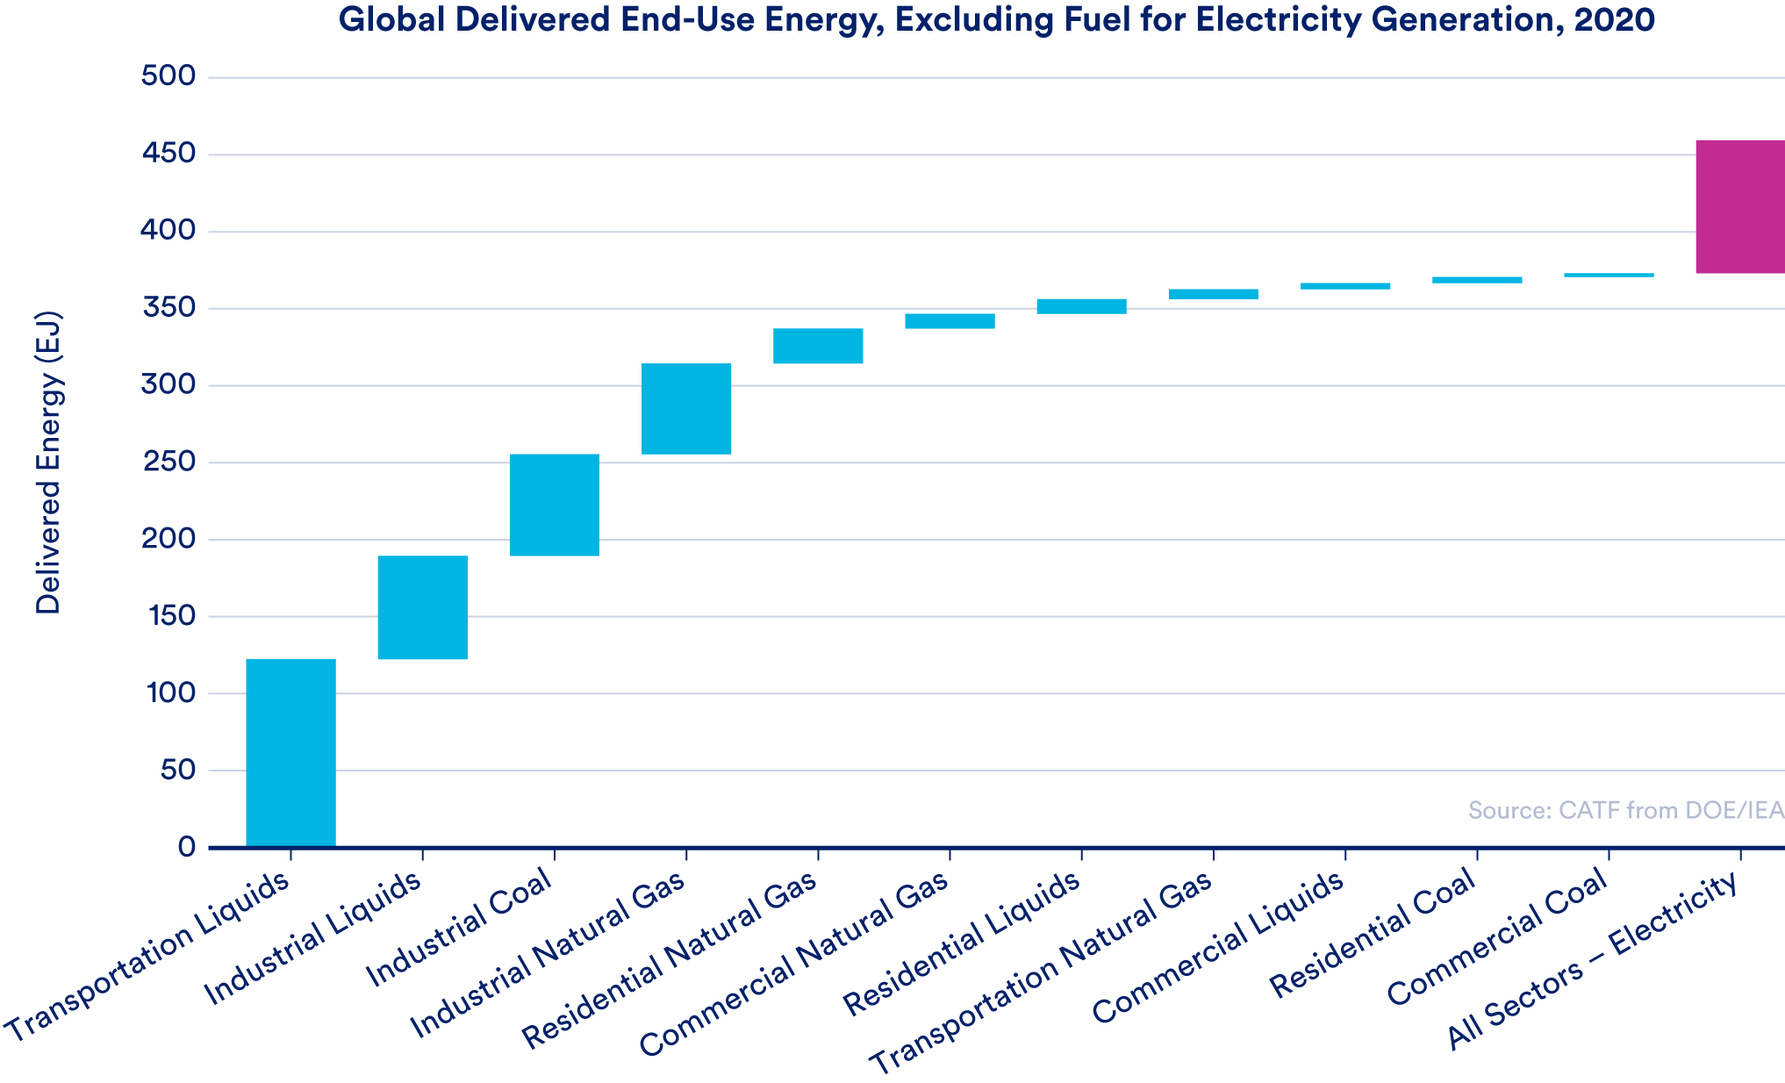
Why Use Nuclear Power Beyond Electricity?

Slide 5
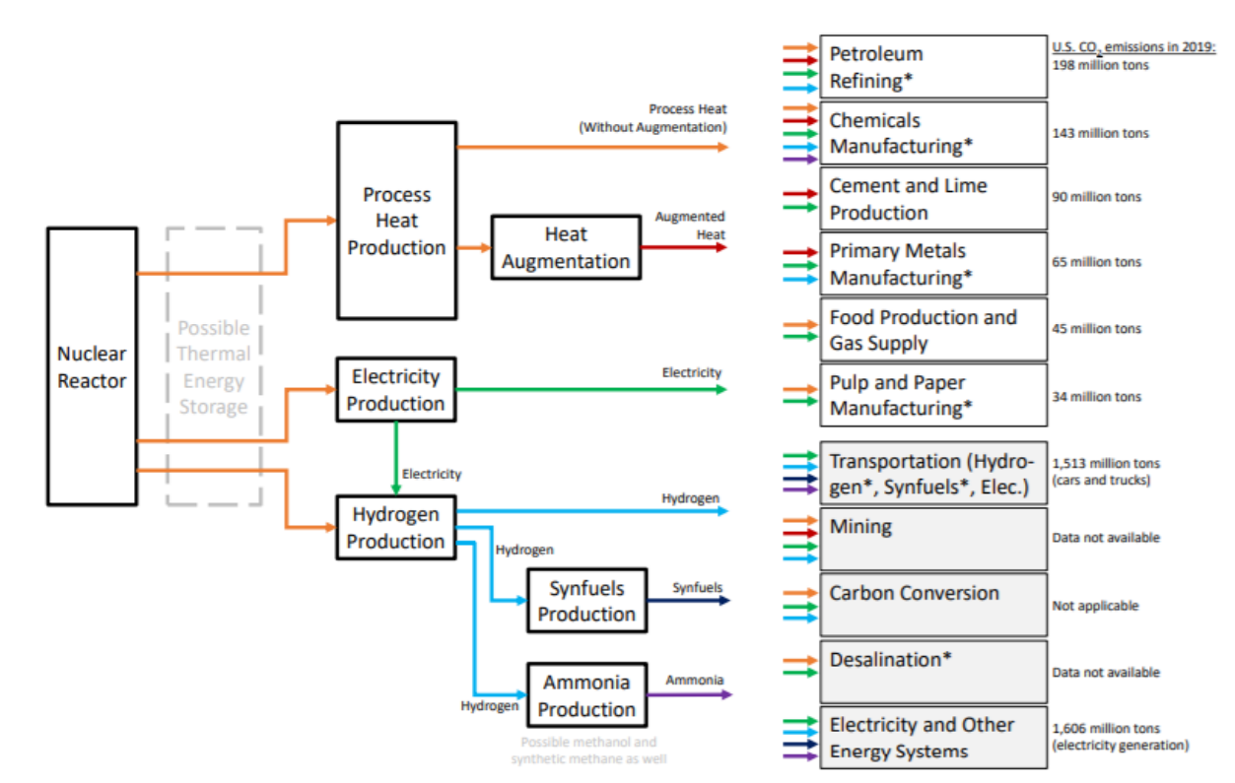
Broadening the Applications of Nuclear Power
Ref: GenIV IF-NEANH
Currently. ~1% nuclear heat has been used for non-electric applications

Slide 6
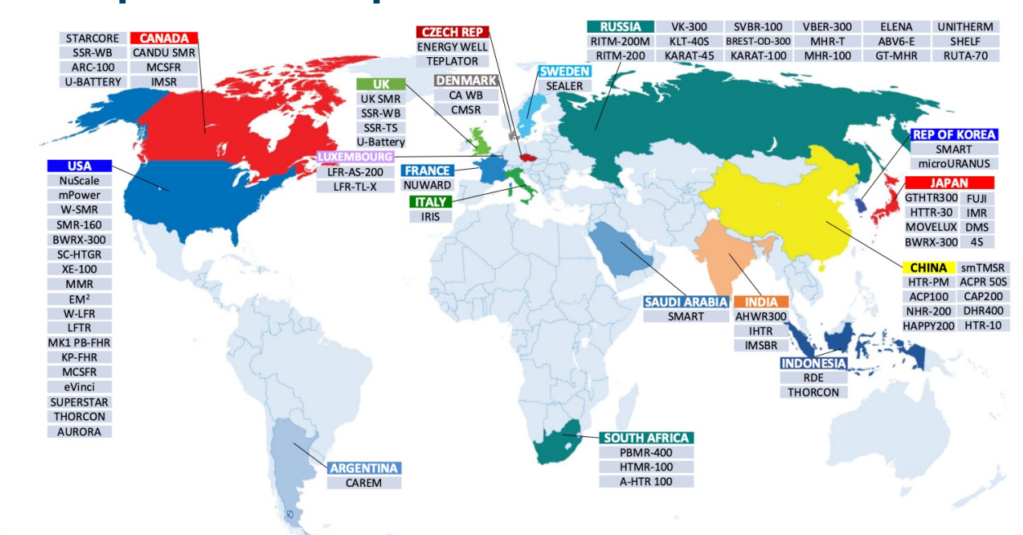
>70 Advanced Reactor Designs Under Development
Ref: IAEA

Slide 7
Ref: S. Qvist

Slide 8
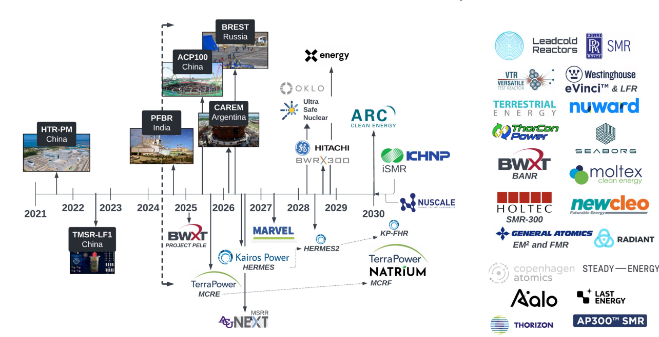
Advanced Nuclear Reactors Timeline - ~30 Concepts
Ref: QuantifiedCarbon / S. Qvist

Slide 9
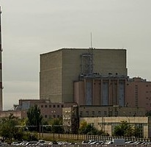
Nuclear & Desalination
The BN-350 fast reactor at Aktau, in Kazakhstan, successfully supplied up to 135 MWe of electric power while producing 80,000 m³/d of potable water over some 27 years to 1999, about 60% of its power being used for heat and desalination.
The plant was designed as 1000 MWt but never operated at more than 750 MWt, but it established the feasibility and reliability of such cogeneration plants.

Slide 10
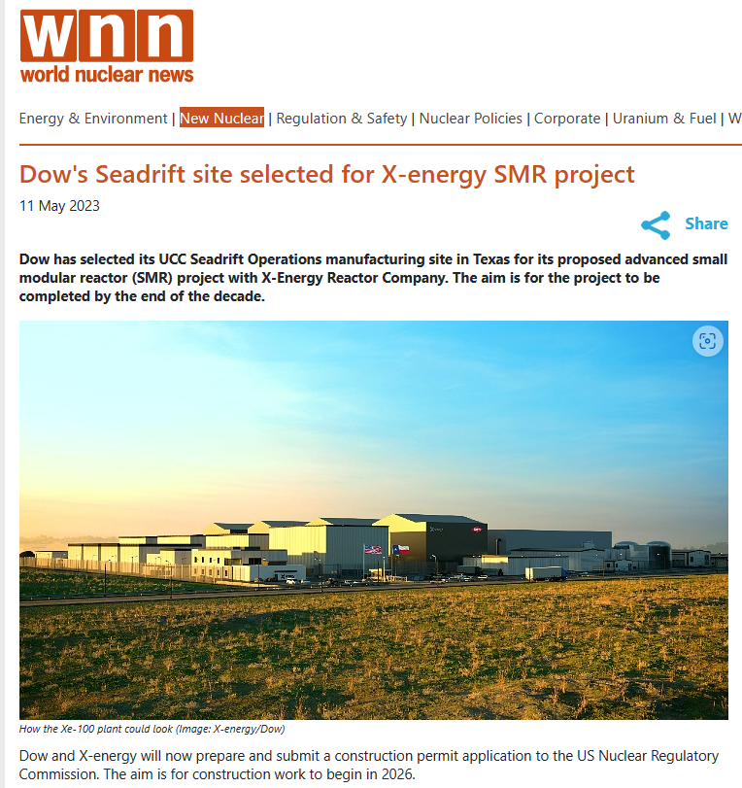
Nuclear and Industrial Applications
Dow Inc and X-energy have agreed to develop and demonstrate the first grid-scale next-generation nuclear reactor for an industrial site in Texas.
The Seadrift site covers 4700 acres and manufactures more than 4,000,000 pounds (1816 tonnes) of materials per year for use in applications such as food packaging, footwear, wire and cable insulation, solar cell membranes and packaging for pharmaceutical products
Each Xe-100 high-temperature gas reactor is engineered to operate as a single 80 MW electric unit, optimised as a four-unit plant delivering 320 MWe, on a roughly 30-acre site. The reactor can provide baseload power to an electricity system or support industrial applications with 200 MW thermal output per unit of high pressure, high temperature steam.

Slide 11
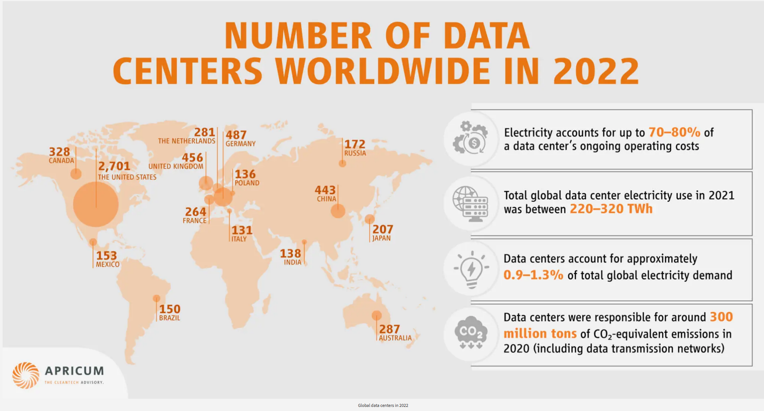
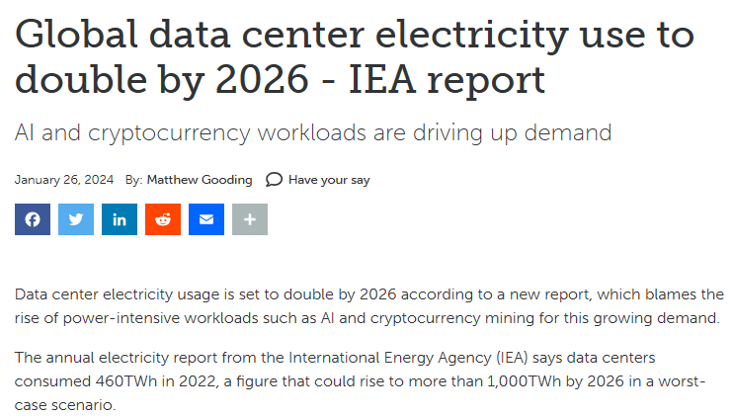
Nuclear and Data Centers
Data centers and data transmission networks are responsible for 1% of energy-related GHG emissions (330 Mt CO2 equivalent in 2020)
Estimated global data center electricity consumption in 2022 was 240-340 TWh, or around 1-1.3% of global final electricity demand. This excludes energy used for cryptocurrency mining, which was estimated to be around 110 TWh in 2022, accounting for 0.4% of annual global electricity demand.
Combined electricity use by Amazon, Microsoft, Google, and Meta more than doubled between 2017 and 2021, rising to around 72 TWh in 2021.
Google, Microsoft, and Nucor partner for new energy tech PPAs.
Focus on accelerating the development of first-of-a-kind and early commercial projects, including advanced nuclear, next-generation geothermal, clean hydrogen, long-duration energy storage (LDES) and others

Slide 12
Hydrogen Production via Nuclear Power Many Pathways to Zero Carbon Hydrogen
Existing Reactors
Gen II / III / III+ (LWR)
Advanced Reactors
Gen IV
Electricity
High Temp
Steam
Low Temperature Electrolysis
High Temperature Electrolysis
Thermo-Chemical
Zero Carbon Hydrogen

Slide 13
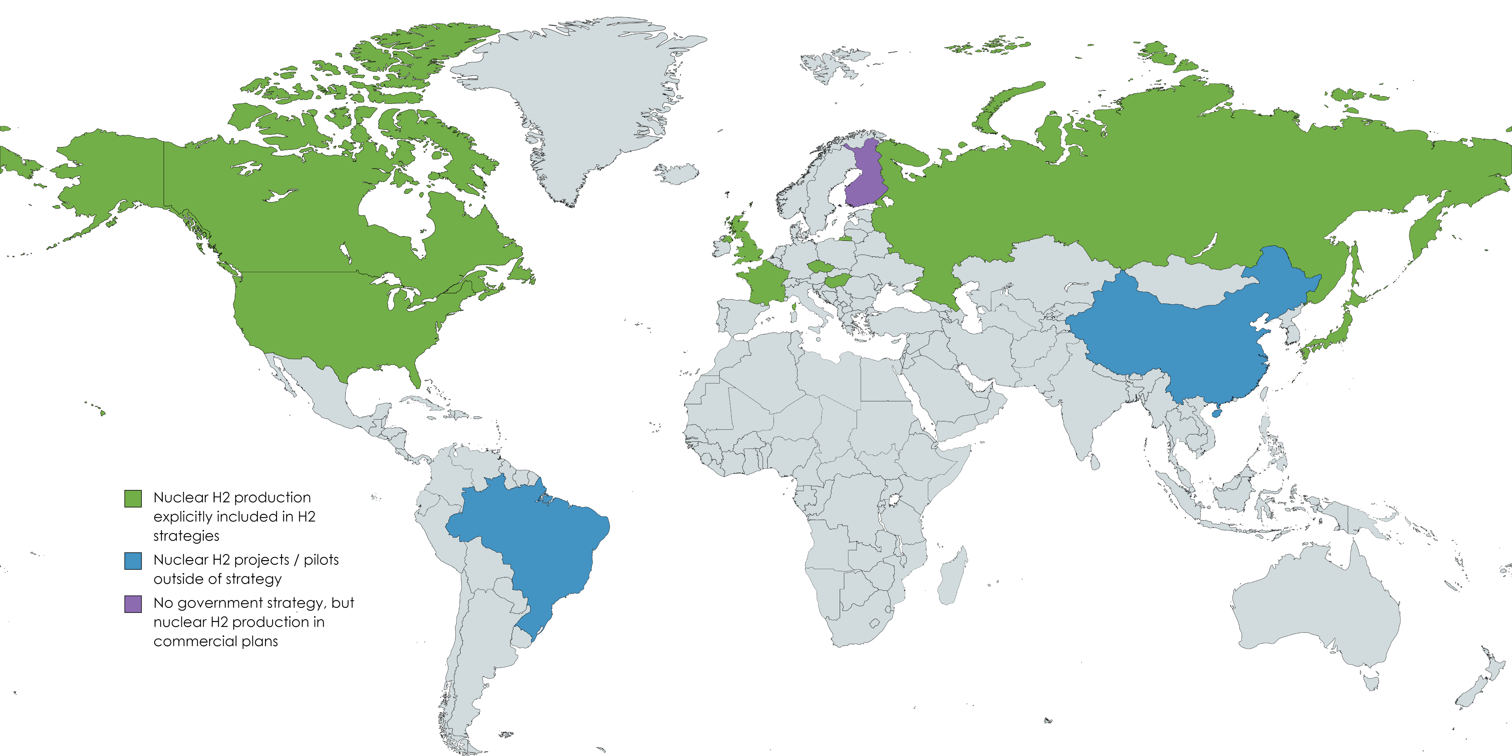
Over 200 low and zero-carbon H₂ projects globally under development
https://www.thehydrogenmap.com
Many Nuclear Hydrogen Demonstration Projects Underway Worldwide and more being planned!

Slide 14
Initiatives to change the global nuclear industry and make nuclear energy relevant to the urgent climate and human development challenges of this century
Move from slow and expensive mega-“projects” to commoditized, standardized, and manufactured “products” supplying large order books.
1
Use demand aggregation to develop large orderbooks and promote repeat builds of the same design.
2
Integrate Plant Delivery Services.
3
Streamline & Harmonize Licensing
4
Technical support for first-time nuclear nations
5
Nuclear energy at scale:
A new pathway to meet the climate and human development challenge
(CATF)
Financing Challenges and Solutions
Set up an International Bank for Nuclear Infrastructure (IBNI)
(https://nuclearbank-io-sag.org/ )
6

Slide 15
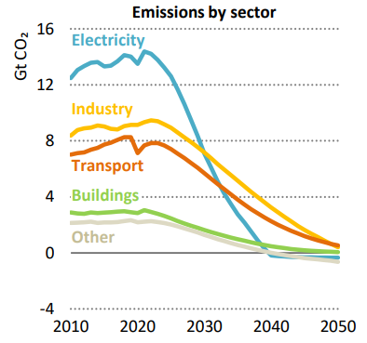
Concluding Thought
Going forward, the energy mix is projected to shift toward power. By 2050, electricity and enabling hydrogen and synfuels could account for up to 50% of the energy mix.
Electricity demand is projected to triple by 2050 as sectors electrify and hydrogen and hydrogen-based fuels increase their market share due to decarbonization
Several energy segments are being challenged to go through the energy transition and Nuclear Energy has a Key Role to Play in Decarbonization
Clean electricity and high temperature heat from nuclear energy can provide broad use to varied applications beyond the traditional nuclear utility role.
SMRs can pave the way for a more significant role nuclear can play in the energy transition.
IEA NZE Scenario

Slide 16
Thank you
Carlos Leipner
Executive Director, LGE Strategic Advisors
cleipner@global-lge.com

