Slide 1
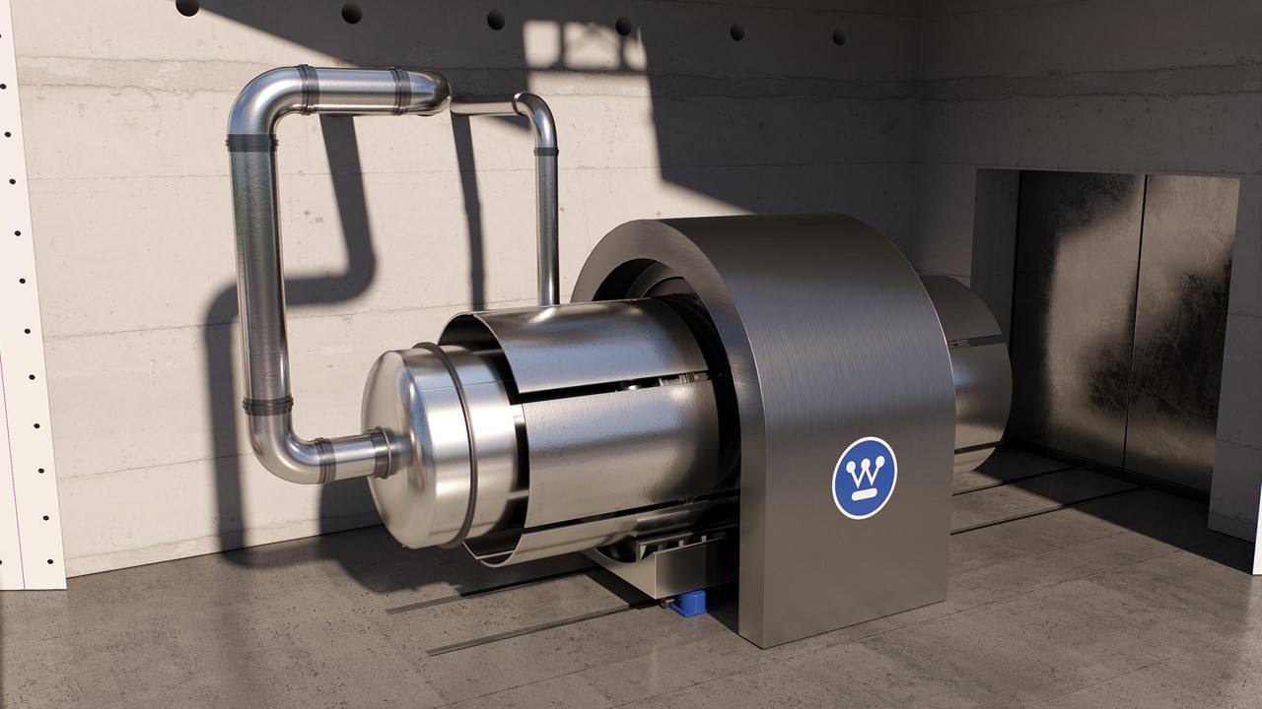
eVinciTM Microreactor
2024 NUCLEAR SUMMIT
Antonio Ramiro
Rio de Janeiro. April, 2024
AP1000®, eVinci™ and AP300™ are trademarks or registered trademarks of Westinghouse Electric Company LLC, its affiliates and/or its subsidiaries in the United States of America and may be registered in other countries throughout the world. All rights reserved. Unauthorized use is strictly prohibited. Other names may be trademarks of their respective owners.
Westinghouse Non-Proprietary Class 3 | © 2024 Westinghouse Electric Company LLC. All Rights Reserved.

Slide 2
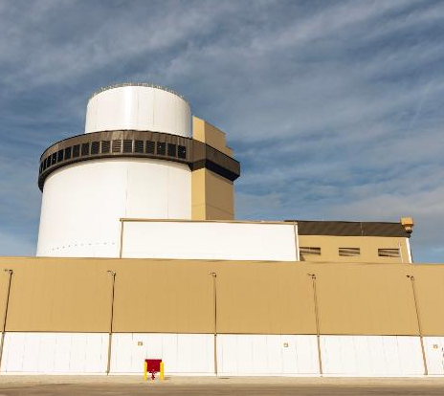
Innovative Solutions Portfolio
Meeting customers’ flexible energy demands by shaping today’s and tomorrow’s energy landscape
AP1000® PWR
~1200 MWe
AP300™ SMR
300 MWe
eVinci™ Microreactor
5 MWe
Westinghouse Non-Proprietary Class 3
© 2024 Westinghouse Electric Company LLC. All Rights Reserved.

Slide 3
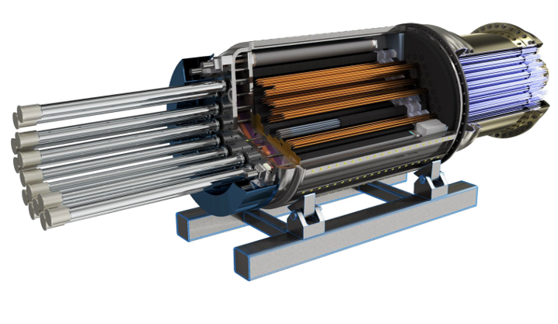
Capable and Simplicity by Design
Nuclear battery designed for safe and reliable electricity and heat generation
Technical Capabilities
5 MWe with ~7MWth @ 170º C usable heat
// 13.5MWth @ > 700º C heat only
Scalable
Minimum 8 year refueling cycle
Eliminates spent fuel storage on site
High speed load-following capability
Transportable
Minimal onsite personnel
Mature technology, manufacturing, and regulatory readiness
Minimal moving parts due to passive cooling through heat pipe technology
Westinghouse Non-Proprietary Class 3 | © 2024 Westinghouse Electric Company LLC. All Rights Reserved.

Slide 4
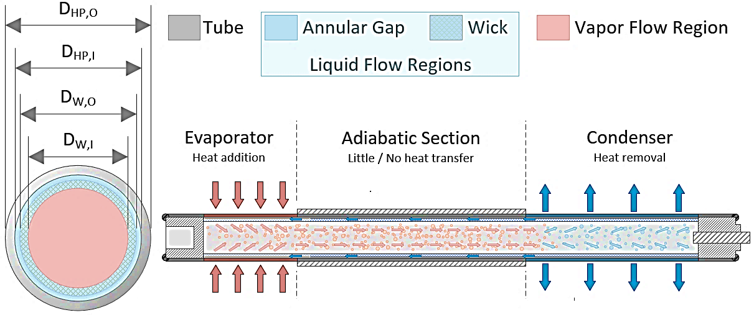
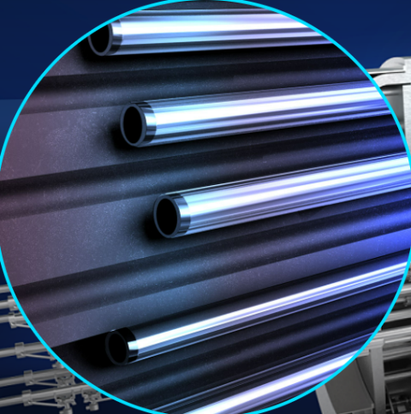
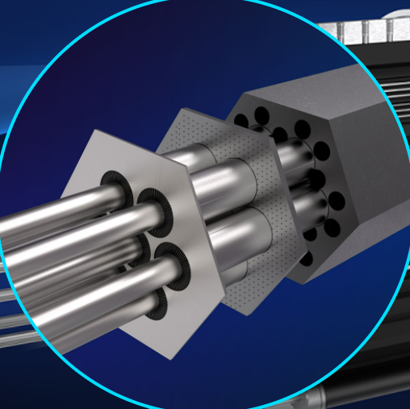
Heat Pipes Enable the Fission Battery Model
Very Low Pressure ● Passive ● Mature technology
Westinghouse Non-Proprietary Class 3 | © 2024 Westinghouse Electric Company LLC. All Rights Reserved.

Slide 5
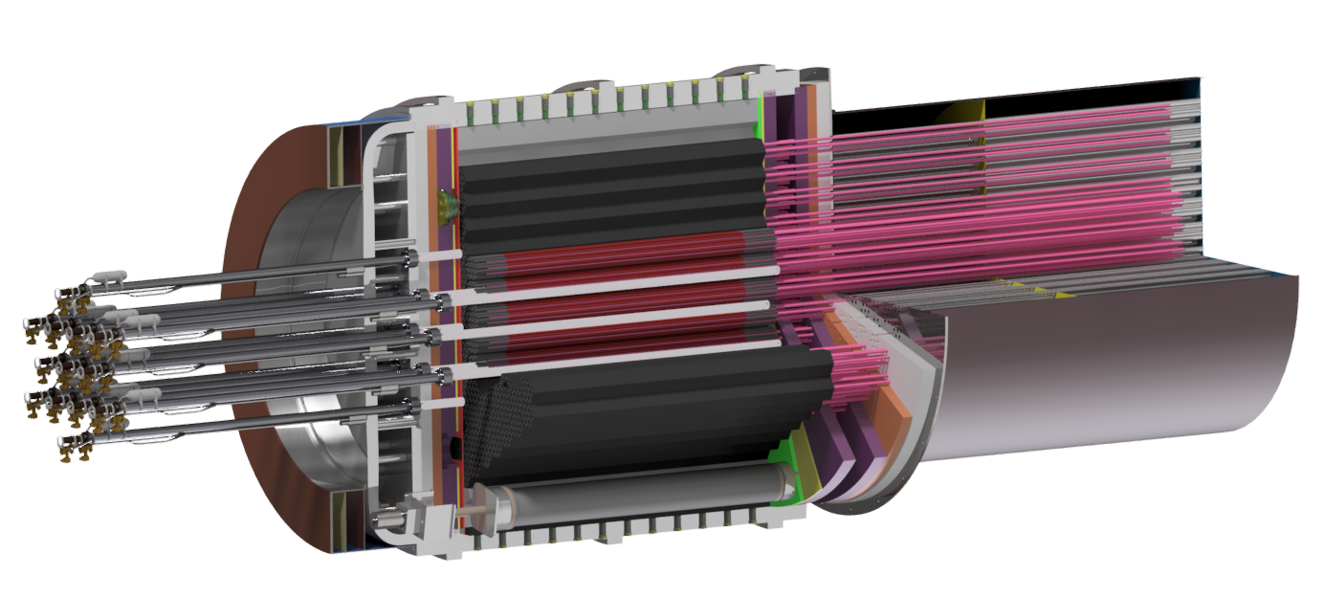
eVinci main components view
Radial Reflector
Fuel
Shielding Assembly
Canister
Heat Pipes
Shutdown Rods
Primary Heat Exchanger
Core Block
Control Drums
Westinghouse Non-Proprietary Class 3 | © 2024 Westinghouse Electric Company LLC. All Rights Reserved.

Slide 6
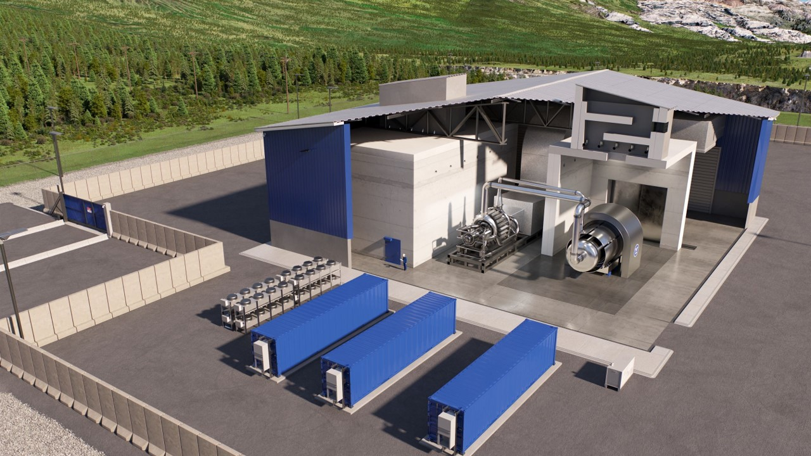
eVinci Site
60x60m building
Modular systems delivered in containers
Security Barriers
Microreactor Replacement Enclosure Bay
Primary Microreactor Unit Enclosure Bay
Power Conversion System
eVinci Microreactor
Instrumentation and Control
Westinghouse Non-Proprietary Class 3 | © 2024 Westinghouse Electric Company LLC. All Rights Reserved.

Slide 7
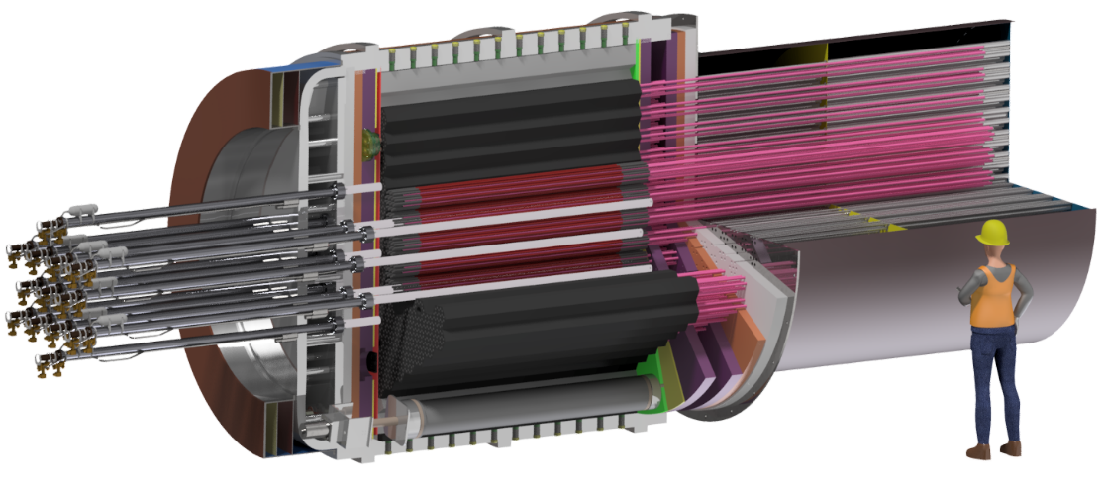
eVinci distributed energy wherever it’s needed
Industrial Heat & Power
Thermal EOR (SAGD, Steam)
Hydrogen Production
Remote Industrial (Mining)
Remote Communities (Heat & Power)
Integrated Power Systems (Micro-Grids)
Power & Heat via eVinci™ Microreactor
Westinghouse Non-Proprietary Class 3 | © 2024 Westinghouse Electric Company LLC. All Rights Reserved.

Slide 8
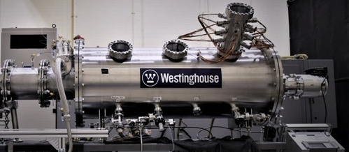
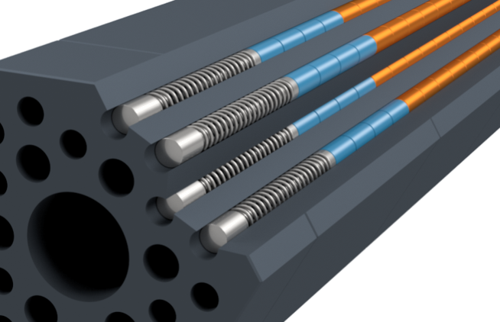
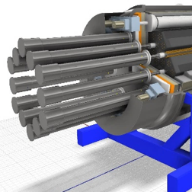
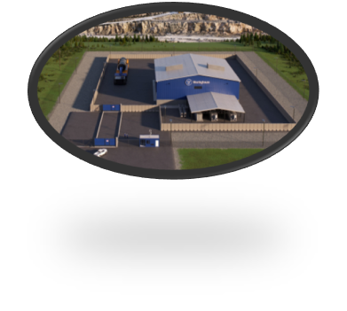
Technology Development and Timeline
NTR design for procurement
Integrated manufacturing demonstrations and prototyping
Separate effect and component testing
Conceptual design complete
Electrical demonstration unit operational
Initiated licensing engagement with US and Canadian regulators
2023
NTR component fabrication
Criticality, transient, and irradiation testing
eVinci design for manufacturing
NTR installation and operation
Initiate eVinci manufacturing
Power conversion system testing
2021–2022
2024-2025
2027+
Analysis code validation
eVinci design complete
Receive regulatory licensing approvals
2026-2027
Westinghouse Non-Proprietary Class 3 | © 2024 Westinghouse Electric Company LLC. All Rights Reserved.
Notes:
Move up in the deck

Slide 9
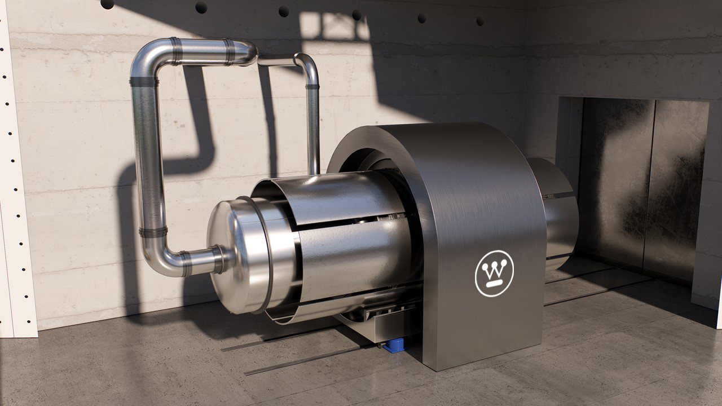
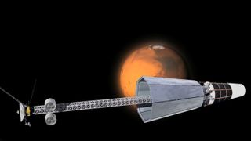
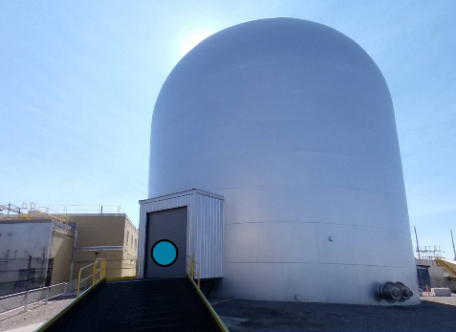
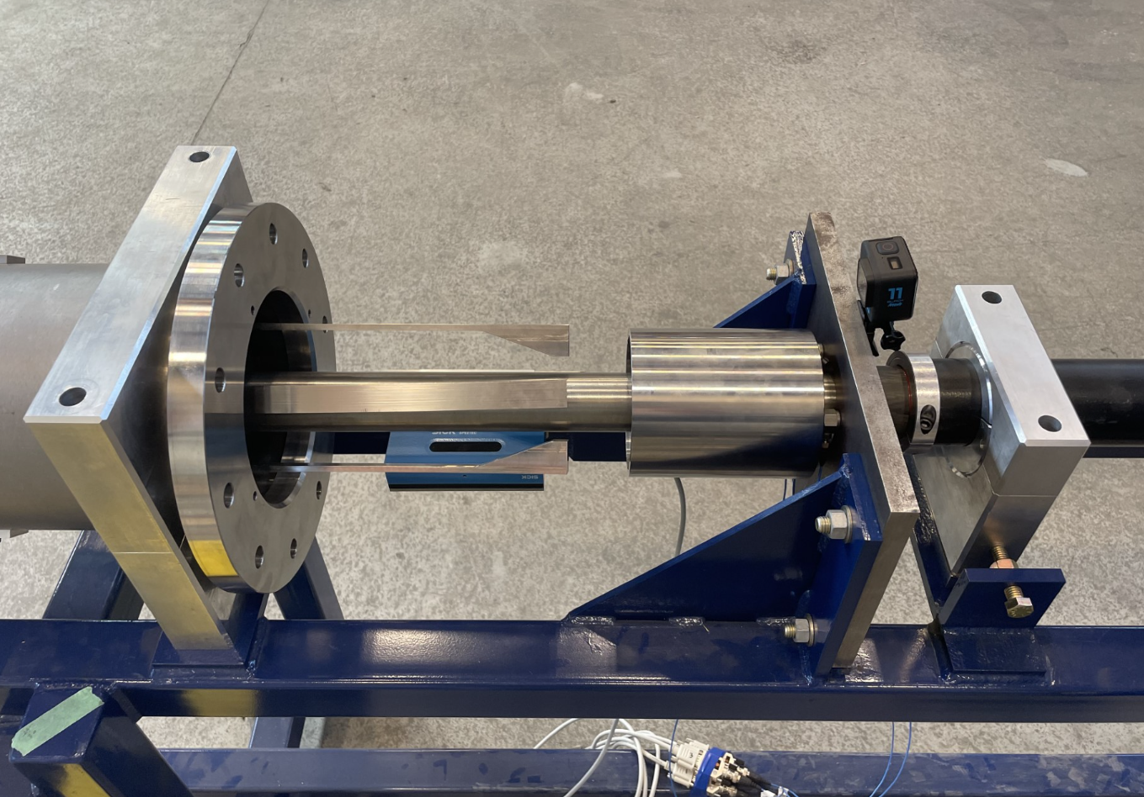
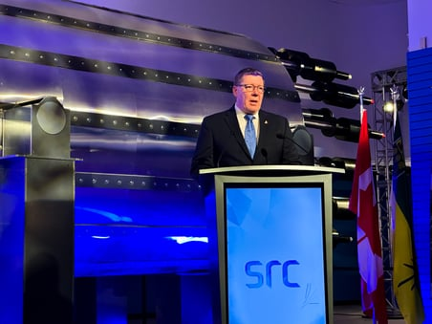
eVinci Achievements - Q4 2023
Selected by Idaho National Labs for FEEED study to plan for deployment of the eVinci Nuclear Test Reactor at INL
October 23
$16.9M awarded from Air Force Research Laboratory's (AFRL) JETSON thermal propulsion contract
October 2
Launch of the eVinci Technologies Accelerator at 51 Bridge St. Etna, PA
October 24
First eVinci customer announcement in Saskatchewan with Saskatchewan Research Council
November 27
Completed testing of key safety components Control Drums and Shut Down Rods
November 6
Westinghouse Non-Proprietary Class 3 | © 2024 Westinghouse Electric Company LLC. All Rights Reserved.

Slide 10
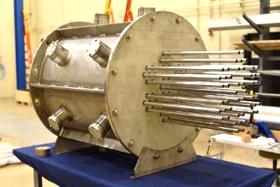
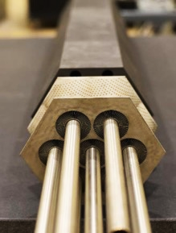
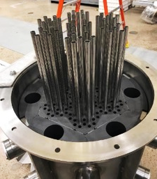
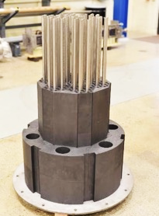
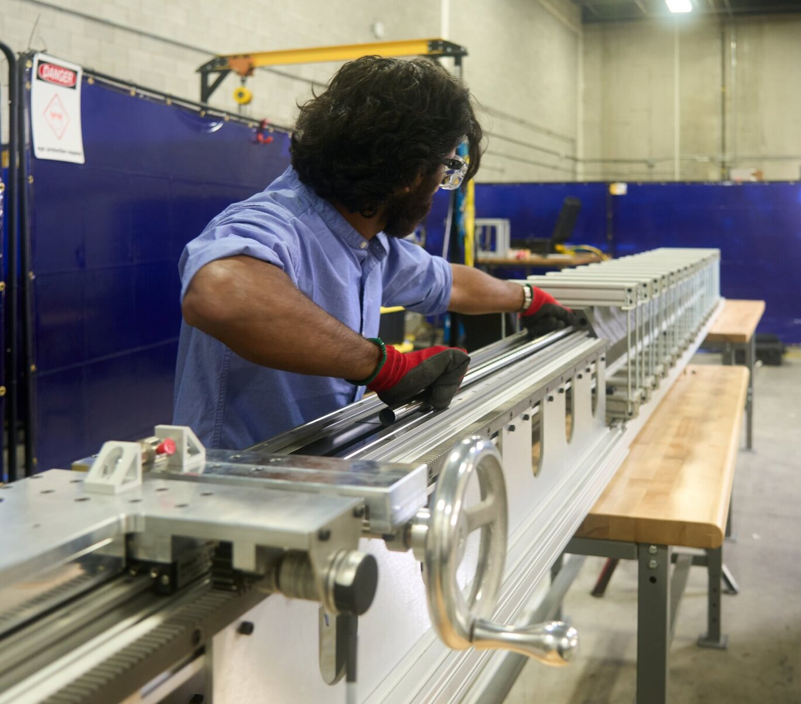
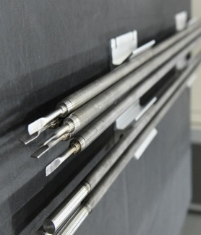
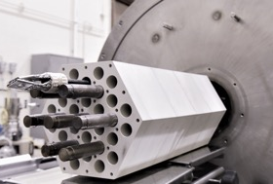
Manufacturing Progress
Westinghouse Non-Proprietary Class 3 | © 2024 Westinghouse Electric Company LLC. All Rights Reserved.

Slide 11
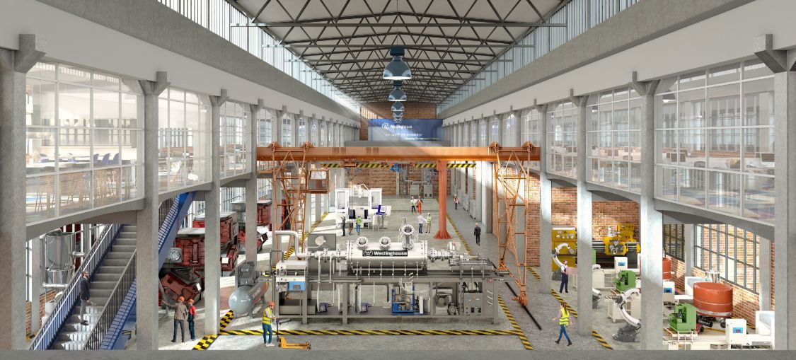
Accelerator Hub (Etna, PA)

Slide 12
Thank You
westinghousenuclear.com
Westinghouse Non-Proprietary Class 3 | © 2022 Westinghouse Electric Company LLC. All Rights Reserved.

